Slide 1
Summary overview report on Eurofer 97 MPH chapter support for year 2016
WPMAT
MAT-1.2.1-T006-D002
F. Gillemot, MTA EK
I. Szenthe, MTA EK
Kovács, MTA EK
E. Gaganidze, KIT

Slide 2

Introduction:
2013-14. MTA EK applied for irradiation and PIE in consortium with SCK-CEN (High fluence SCK-CEN, low fluence MTA-EK)
Modelling, Flux effect, materials behind the first wall etc.
Application accepted, but……
MTA EK participated in IAEA IRPVMD database, in ITER MPH elaboration.
Decision: MTA EK knowledge may used in WPMAT at elaboration DEMO MPH and Material Database
2014 Harmonized Material Database and MPH structure with sample files for structural, joint, armour, and functional materials prepared, accepted
2015. Decision that only functional materials database is the task of MTA EK and the elaboration of EUROFER97 MPH, in co-operation with KIT using the KIT structural materials database.
2015 The first version of EUROFER MPH elaborated in the format accepted
in 2014. Suggestions: change the format for book, etc.
Notes:
2

Slide 3
Objectives:
To summarize the available knowledge on EUROFER properties for designers and to finalize the DEMO MPH format
Tasks in 2015
As part of the WBS1.2 goal to develop a material handbook summarising the database content at a higher level.The target for 2015 is to generate and release a Material Property Handbook (MPH) for at least one material.
Each data point should then be subject to panel review in a meeting amongst all of the participating Research Units.
Participating RU-s should use different data evaluation, compare and agree on the use
Design allowances should be calculated and included (discussion)
Task in 2016
Implement organisational, content and editorial changes to the EUROFER97 MPH based on comments and peer review of 2015 deliverable

Slide 4
Co-operation MTA-KIT:
Document on the IDM: Database, PPPT Material Properties Handbook on EUROFER (KIT, 2015)
Personal day in 2015
VC meetings
Monitoring
E-mails, several corrections, questions etc.
ITER- meetings in every quarters and electronic connection
3 years work on 1 chapter
Group: S. Zinkle, F. Tavassoly, J. Rensman, V. Barabas, E. Diegele, A. Peacock, (+Japan, Korean, Russian, etc participants)

Slide 5
Working method 1: Selection of the content of the MPH (EUROFER97)
(from the general MPH list elaborated 2014) useful for the designers.
Selected 25 properties
General information on EUROFER97, Chemical composition
Density, Yield strength, Tensile strength,Elongation,
Reduction of area,Young’s modulus,Poisson’s ratio
CHARPY impact energy, Fracture toughness, Fatigue-crack-growth rate
Fatigue, Creep, Linear thermal expansion, Thermal conductivity
Thermal diffusivity, Specific heat,Electrical resistivity,Magnetic saturation
Remnant magnetization, Coercive field
Empty sheets:Swelling, Ratchetting, and Melting Temperature
Not selected: dielectric and optical properties etc.

Slide 6
Working methods 2:
Collection MPH data are from 2 sources: database, literature
Step2. Selection of relevant data
Data quality:
High - original report or database made from original reports
Low to high – public data (conferences, journals etc.) consideration on quality
No identification – very low or useless
Identification – enough data to get the same quality

Slide 7
Working methods 3
Data treatment in case of as received material data:
From database:
Selection the relevant data
Fit average curve in the function of temperature
(Polinomial, or specific function )
Check the scatter
Consider outliner
Reduction of the scatter by special treatment (SYNTAP, Bootstrapping etc.)
Draw the curve in uniform format
Convert diagram to picture, delete data points
Calculate the values belonging to design temperatures
Check with participants
Correction re-evaluation if necessary
Copy into the MPH

Slide 8

Working method 4:
Description of the property
The density, or more precisely, the volumetric mass density [kg/m³ or g/cm³], of a substance is its mass per unit volume. The symbol most often used for density is ρ (the lower case Greek letter „rho”). Mathematically, density is defined as mass divided by volume:
where ρ is the density, m is the mass, and V is the volume

Slide 9
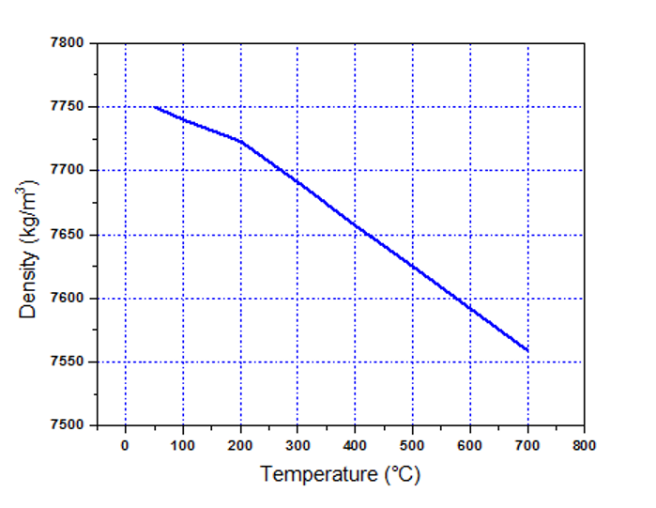
Working method 5
Temperature | Density
°C | kg/m³
20 | 7744
50 | 7750
100 | 7740
200 | 7723
300 | 7691
400 | 7657
500 | 7625
600 | 7592
700 | 7559
Figure-general information
Table – values at design temperatures
Polynomial: interpolation and check

Slide 10
Working method 6:
Attach the relevant references: standards, literature
ASTM E-6-03 “Standard Terminology Relating to Methods of Mechanical Testing”
ISO-6892:1998. Metallic Materials-Tensile testing
ASTME8/8M Standard Test Methods for Tension Testing of Metallic Materials
E. Gaganidze: “Final report on PPPT Material Property Handbook on Eurofer” (KIT, 2015)
F. Tavassoli: “Comparison of 316L(N) -IG and Eurofer for Early DEMO”. EFDA-WP13-MAT-02-01
N.V. Luzginova, J.-W. Rensman, M. Jong, P. ten Pierick, T. Bakker, H. Nolle: “An Overview of 10 Years of Irradiation Experiments on EUROFER97 Steel at High Flux Reactor in Petten” Journal of Nuclear Materials Volume 455, Issues 1–3, Pages 1-73 (December 2014)
F. Tavassoli, “Eurofer Steel, Development to Full Code Qualification”, in 6th International Conference on Creep, Fatigue and Creep-Fatigue Interaction [CF-6],Procedia Engineering 55 (2013) 300-308
F. Tavassoli, E. Diegele, R. Lindau, N. Luzginova, H. Tanigawa:” Current status and recent research achievements in ferritic/martensitic steels” Journal of Nuclear Materials Volume 455, Issues 1–3, p. 269-276

Slide 11
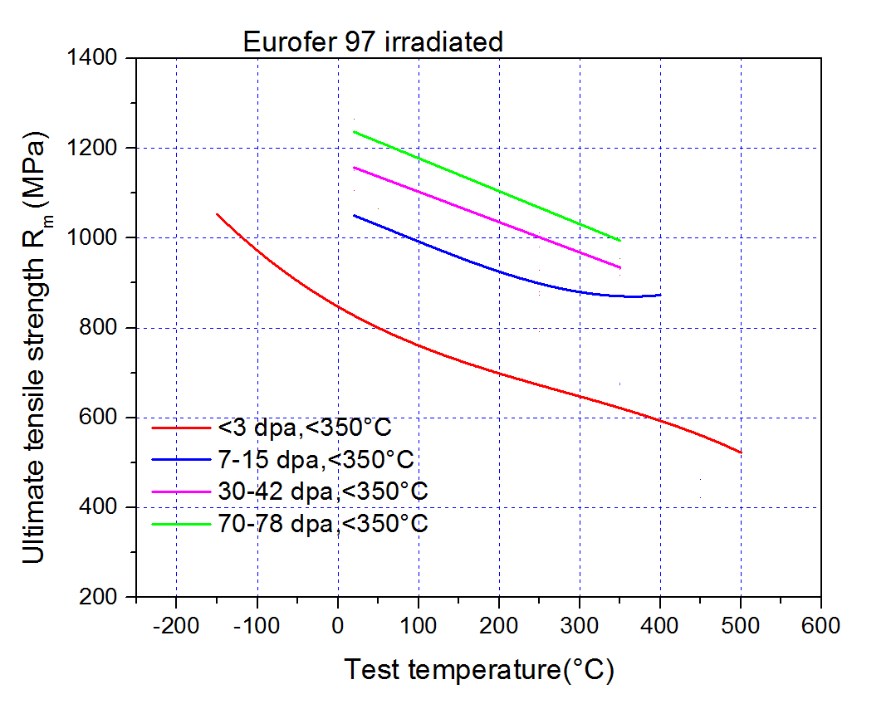
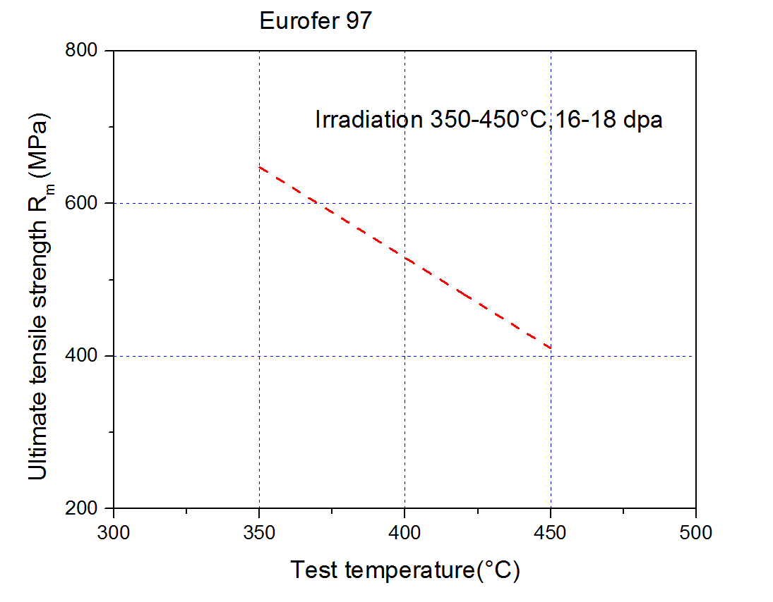
Working method 7
Aged material
Few data irradiated with different fluences and tested on different temperatures
Selection of groups (many variation, discussion)

Slide 12
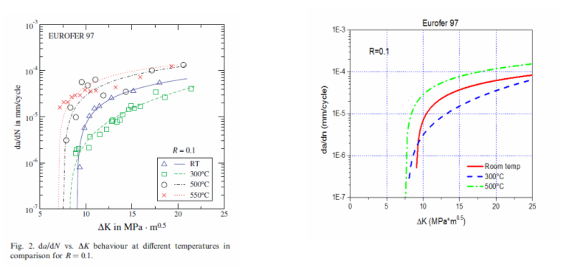
Working method 8:
Redigitalising and redraw and simplify the information

Slide 13
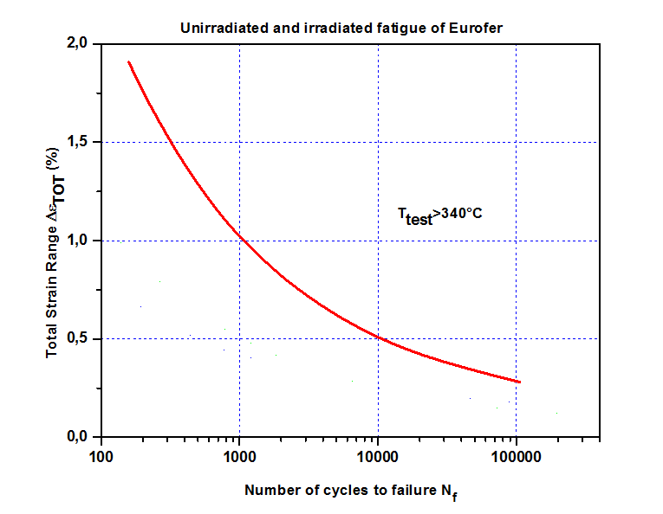
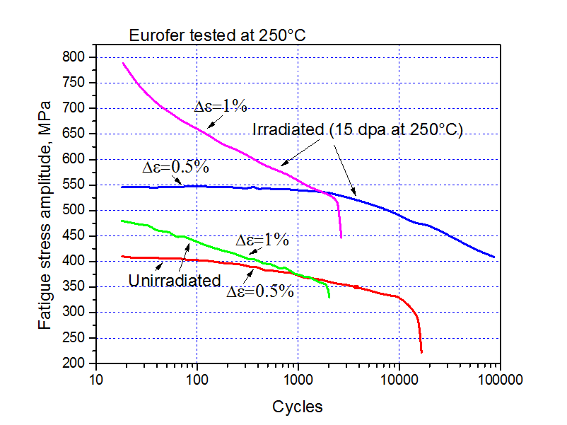
Working method 9:

Slide 14
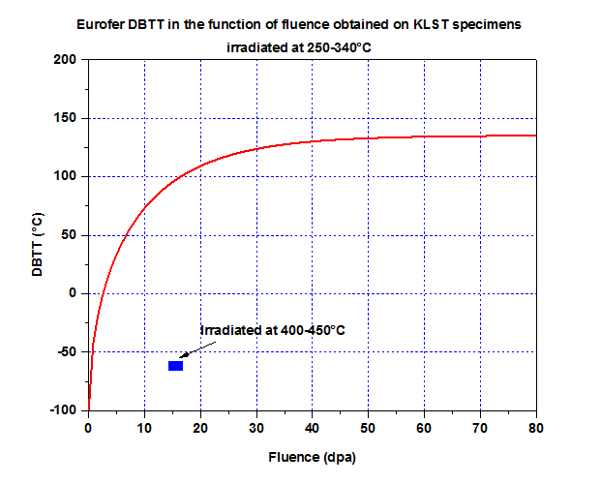
Working method 11: example KLST testing evaluation
18 KLST group
Several attempt
Discussion with KIT
Selection of the best one
Trend curve fit
Full Charpy again

Slide 15
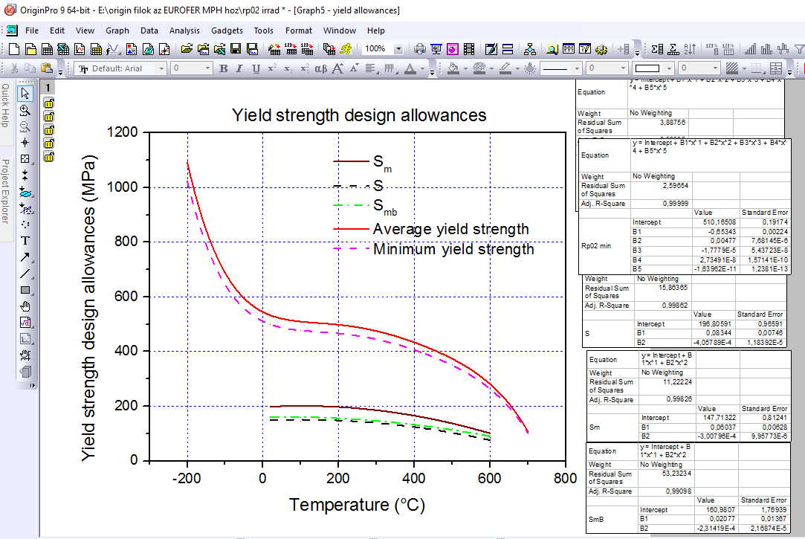
Working method 12: example for analysis of data

Slide 16

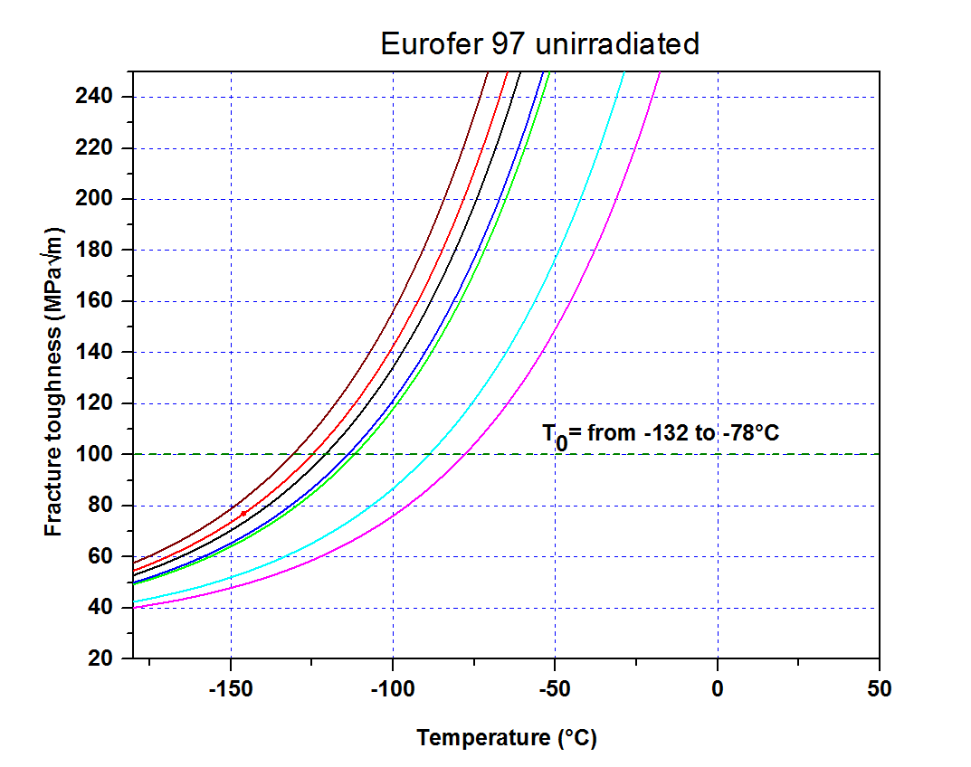
Working method 13: Master curve
K_{jc(mean 1T)} = 30+70*exp[0.019*(T-T₀)]
1°C difference KIT-MTA

Slide 17
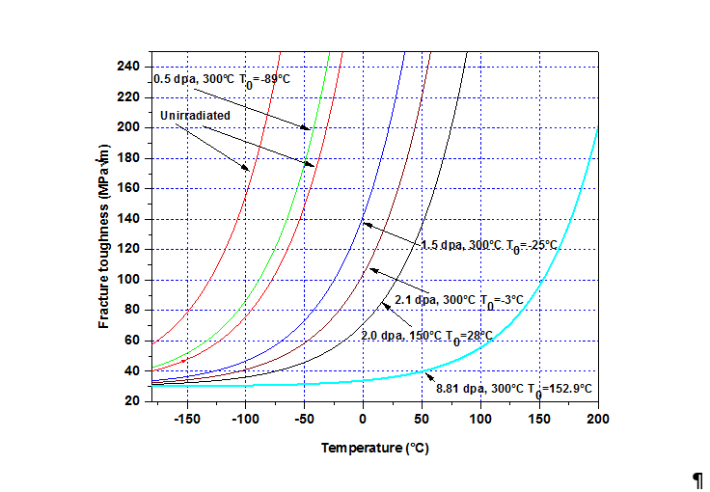
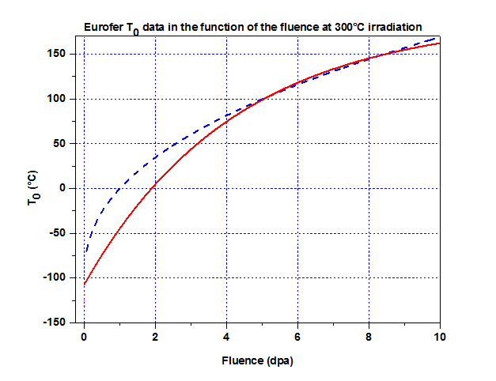
Working method 14: Master curve irradiated Eurofer

Slide 18
Working method 15: polynomial and other fit simplification
Ageing conditions | Polynom to calculate the tensile strength (MPa)
<3 dpa, <350 °C | 845.4-1.033*T+0.0021*T²-2.5217E-6*T³
7-15 dpa, <350 °C | 1071.1-0.987*T+0.00119*T²
30-42 dpa, <350 °C | 1170.5-0.675*T
70-78 dpa, <350 °C | 1251-0.7332*T
The fitting programs may give 6-8 decimals. It is too long to use (consider a 5th polynomial!
Sensitivity analyses of each constants. Max deviation limited to 1 MPa.

Slide 19
Design allowances:
Material parameter modified by Code related safety factors
Agreement: use of RCC-MRxx 2012
Provided by KIT
MTA EK checked the values
Design allowance
 | The smallest value of
S | 2/3* R_{p02} _{min}(20°C), 2/3* R_{p02} _{min}(θ),1/4* R_{m} _{min}(20°C), 1/3.6* R_{m} _{min}(θ)
S_{m} | 2/3* R_{p02} _{min}(20°C), 2/3* R_{p02} _{min}(θ),1/3* R_{m} _{min}(20°C), 1/2.7* R_{m02} _{min}(θ)
S_{mB} | 1/3* R_{p02} _{min}(20°C), 1/3* R_{p02} _{min}(θ)

Slide 20
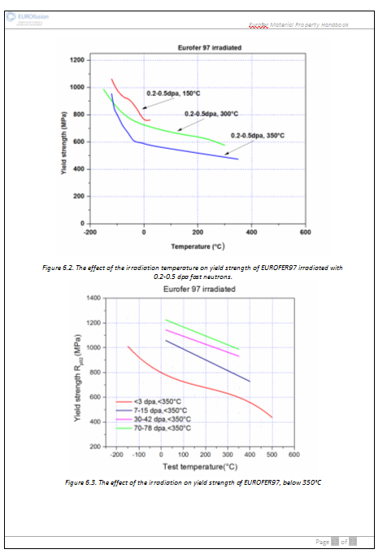
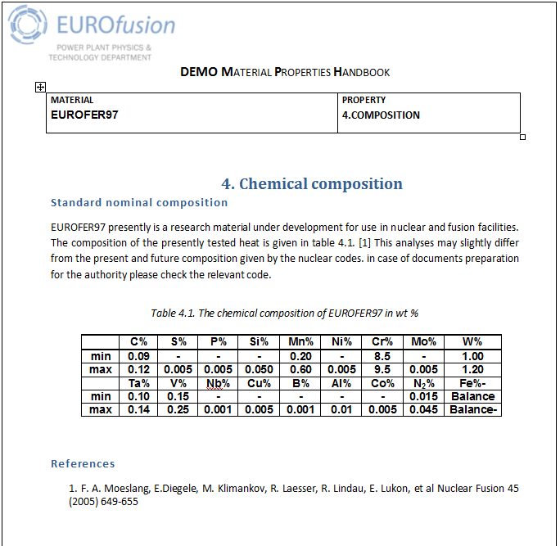
Deliverable: EROFER MPH version 2016. Ready (small edits until the end of the year may performed)
78 pages,

Slide 21
Acceptance criteria:
Project management check –performed
Discussion with the designers- done
Results:
Ready MPH on Erurofer.
Sample for other chapters (next functional materials)
Experience in co-operation with KIT
Experience of databse analyses
Conclusions:
The task is finished, the deliverable is ready in time
EUROFER MPH is not continued in 2017

Slide 22

Thank you very much for Your attention!
Notes:
22

